Slide 1

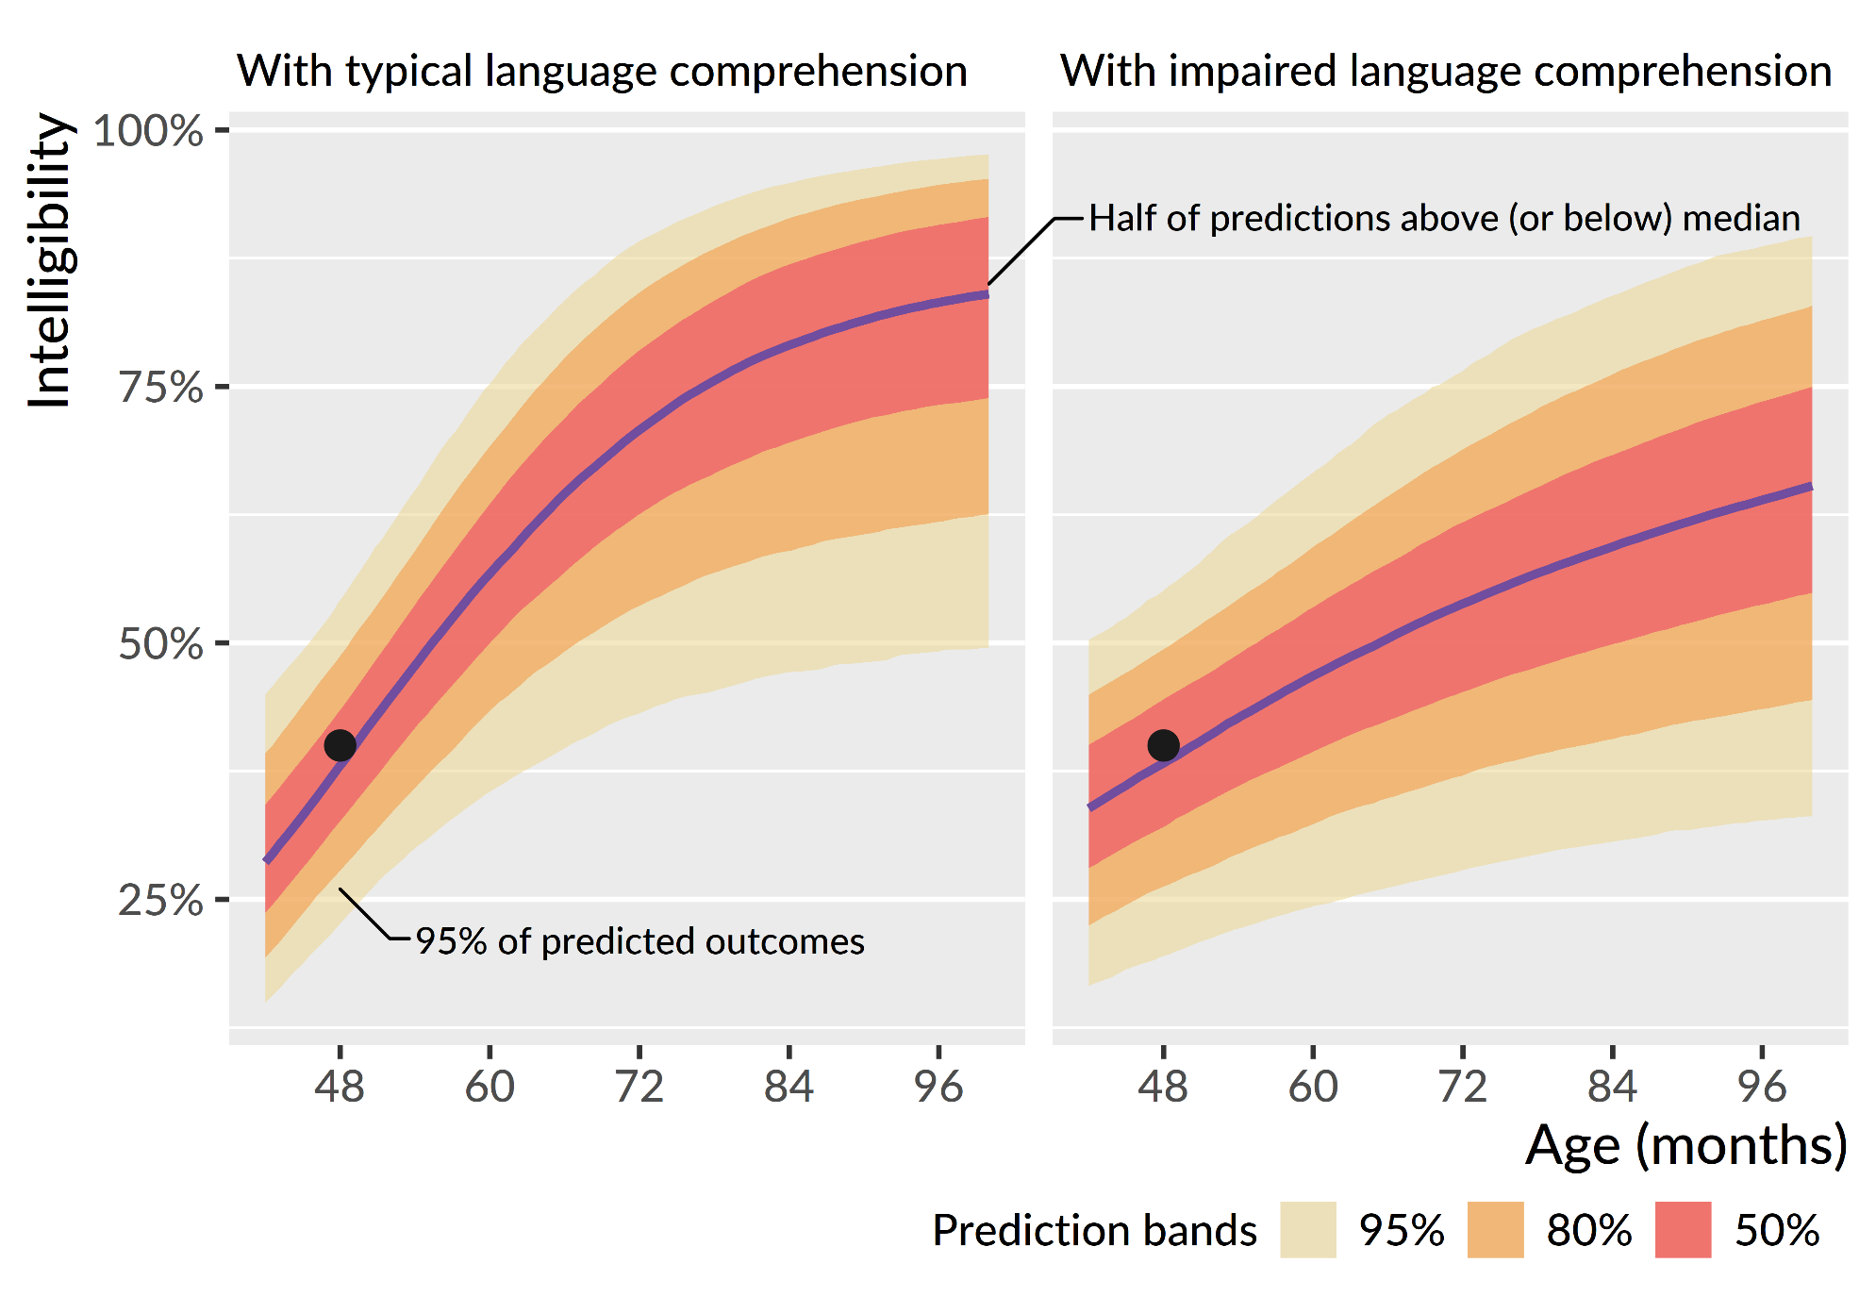
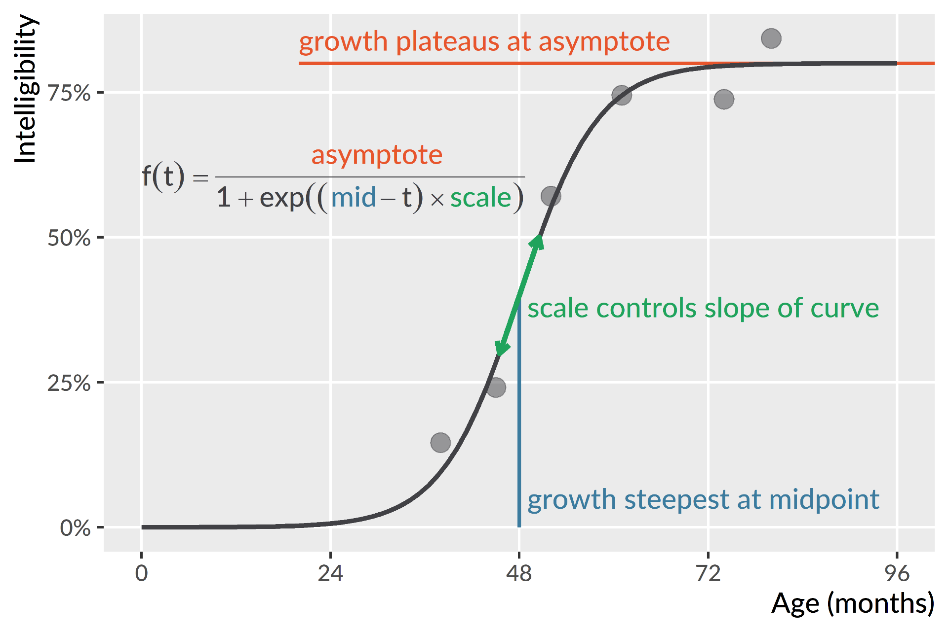
Intelligibility in multiword utterances in children with cerebral palsy
Tristan Mahr, Phoebe Natzke, Katie Hustad University of Wisconsin–Madison
Background
Children with cerebral palsy (CP) commonly have a speech-motor disorder (dysarthria) with speech-subsystem impairments that can be observed and described.
But this kind of subsystem description does not reveal how functional a child’s speech is for communication.
Intelligibility measures the degree to which a listener can recover a speaker’s intended message, so it provides a practical measure of speech communication.
Current study
How does intelligibility in connected speech develop in children with CP from age 2 to age 8?
How does language ability at age 4 differentiate children’s growth trajectories?
Method
Participants
Data were collected as part of an ongoing longitudinal study.
Participants ranged in age from 24 to 96 months-old, averaging 7.9 visits per child (SD: 2.3, range: 2–12).
Children were classified into three speech-language profiles using data from their 48-month visit (or the earliest visit after 48 months)
Intelligibility measure
Children repeated 2-7-word sentences.
Untrained listeners transcribed children’s utterances; they were played the productions and instructed to type out the words the child said.
Every child’s visit had transcriptions by two listeners.
Each listener only heard the productions from a single visit.
A child’s intelligibility for a visit was the percentage of words correctly identified by listeners.
Nonlinear growth curve analysis
We used Bayesian mixed-effects nonlinear beta regression to model how intelligibility developed with age.
We estimated the average intelligibility growth curve for each profile group, the distribution of growth curves across children, and the precision of the intelligibility measurements in each group.
Observed intelligibility scores and estimate developmental trajectories. The top row shows the observed intelligibility measures, which can be volatile within a child (some lines move up and down). The bottom row shows the trajectory inferred from the observations.
Logistic growth curve. We expected children to follow a certain developmental trajectory: Begin at zero intelligibility, show a period of accelerating then decelerating growth, and eventually plateau. This pattern can be modeled using a three-parameter logistic growth curve (right). This curve is flexible enough to capture many patterns—sudden growth (sharp slope), delay (later midpoint), or no change at all (low asymptote)—so these parameters provide a way to estimate group-level and individual differences.
Group differences in average intelligibility trajectories. We estimated the average growth curve trajectory in each group. The trajectories of the children with dysarthria and language comprehension impairment in our sample were quite heterogeneous, so the model had much more uncertainty about the group’s average growth curve.
Conclusions
Even though the children showed highly variable patterns of development, speech-language profile groups at age 4 captured developmental similarities.
A child without dysarthria probably already have had their window of fastest growth by age 4. A children with dysarthria and normal language is likely still developing during age 4.
Children with dysarthria and language impairment probably have lower intelligibility attainments than their peers. This finding could reflect how language impairment predicts greater overall motor impairment.
Application: Probabilistic prediction. Suppose we meet a 4-year-old child with CP who has dysarthria with 40% intelligibility.
What developmental trajectories are plausible?
 | No dysarthria (n = 22) | Dysarthria with typical language comprehension (n = 31) | Dysarthria with impaired language comprehension (n = 12)
Mean (SD) number of visits | 9.0 (2.1) | 9.0 (2.0) | 7.2 (2.2)
Median number of visits | 9.0 | 9.0 | 6.5
Ratio Male:Female | 17:5 | 11:20 | 6:6
The authors have no financial or non-financial conflicts of interest.
Funding provided by NIDCD R01 DC009411 and U54 HD090256.
Symposium on Research in Child Language Disorders
Madison, WI: June, 2019
Contact: Tristan Mahr (tristan.mahr@wisc.edu)

